Slide 1
Procedures: Splinting
Northwestern EM ortho curriculum

Slide 2
Indications for Splinting
Acute arthritis, including acute gout
Severe contusions and abrasions
Skin lacerations that cross joints
Tendon lacerations
Tenosynovitis
Puncture wounds/bites to the hands, feet, and joints
Fractures and sprains
Reduced joint dislocations

Slide 3
Splinting Equipment
Stockinette
Splinting material
Plaster of Paris (at NMH)
Strips or rolls (2-, 3-, 4- or 6-inch widths)
Prefabricated Splint Rolls
Plaster
Fiberglass with polypropylene padding (at CMH)
Padding (Webril)
Ace Wrap
Bucket/receptacle of warm water
Trauma sheers

Slide 4
Plaster Preparation
Length: Measure out the dry splint at the extremity to be splinted
remember the plaster shrinks slightly when wet, if too long, the ends can be folded back
Use plaster width that is slightly greater than the diameter of the limb
Can be measured on the contralateral extremity to avoid excessive manipulation of the injured extremity
Thickness:
UE: 8-10 layers
LE 10-12 layers

Slide 5
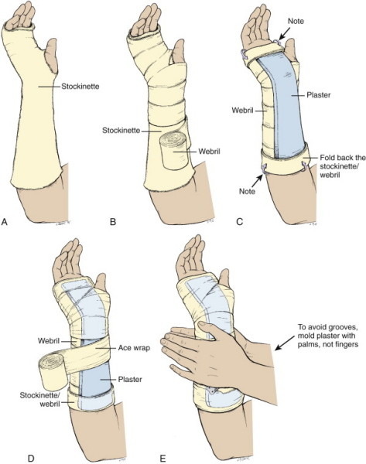
General Splinting Procedure
Stockinette is applied
Webril is applied
The wet plaster is positioned
Elastic bandage is applied
The plaster is molded

Slide 6
General Splinting Procedure
Measure and prepare the plaster
Apply the stockinette so that it extends 2 or 3 inches beyond the plaster
Apply 2 or 3 layers of Webril over the area to be splinted
Be generous
Avoid wrinkles
Place extra padding around bony prominences
Place Webril between digits that are going to be splinted to avoid maceration
Wet the plaster and place it over the area to be splinted
Submerge the premeasured plaster in unused warm water
Remove the splint from the water and squeeze out the excess water and remove wrinkles
Fold the ends of stockinette over the the plaster to smooth the edges of the splint

Slide 7
General Splinting Procedure (cont’d)
Place a layer of Webril over the plaster
Apply the ace wrap around the splint to secure it in place
Unwrap the bandage without placing too much tension around the extremity
While still wet, mold the plaster to conform to the shape of the extremity
Use the palms of your hand rather than the fingers
Place the patient’s extremity in the position desired
Keep the patient still until the splint has dried and hardened (the plaster will become warm as it’s drying)
Fast-drying: 5-8 minutes
Extra-fast drying: 2-4 minutes
After the splint has dried, check the splinted extremity for function, arterial pulse, capillary refill, temperature of skin, and sensation

Slide 8
Specific Splints
Upper Extremity
Lower Extremity
Long arm posterior splint
Double sugar tong splint
Volar splint
Sugar tong splint
Thumb spica splint
Ulnar gutter splint
Radial gutter splint
Finger splints
Posterior knee splint
Jones compression dressing
Posterior ankle splint
U-splint/stirrup splint

Slide 9
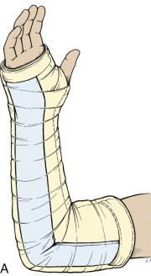
Long Arm Posterior Splint
Indications
Injuries of the elbow and proximal forearm
Construction
Starts on the posterior aspect of the proximal arm
Down the ulnar aspect of arm
Ends at the MCP joints
Application/Positioning
Cut hole in stockinette for thumb
Elbow at 90 degrees
Forearm neutral position with thumb up
Neutral or slightly extended wrist (10 -20 degrees)

Slide 10
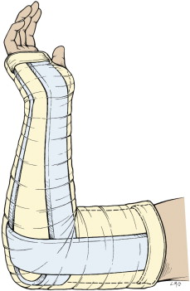
Double Sugar Tong
Indications
Complex and unstable forearm and elbow fractures
Construction
Forearm splint –from MC heads on the dorsal hand, around elbow to volar MCP joints
Arm splint – from anterior proximal humerus, around elbow, to posterior arm to prox humerus
Application/Positioning
Cut hole in stockinette for thumb
Elbow at 90 degrees
Forearm neutral with thumb up
Slightly extended wrist (10 -20 degrees)

Slide 11
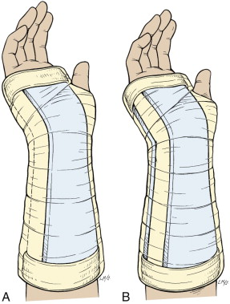
Volar Splint
Indications
Soft tissue injuries of the hand and wrist
Carpal bone fractures, 2nd – 5th MC head fractures
Construction
Starts in the palm at the MC heads, down the volar aspect of forearm to distal forearm
Application/Positioning
Cut hole in stockinette for thumb
Forearm in neutral position with thumb up
Wrist slightly extended (10-20 degrees)

Slide 12
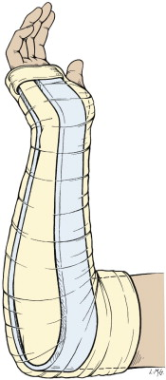
Sugar Tong Splint
Indications
Distal radius and ulna fractures
Construction
From MC heads on the dorsal hand, around elbow to volar MCP joints
Application/Positioning
Cut hole in stockinette for thumb
Elbow at 90 degrees
Forearm neutral with thumb up
Slightly extended wrist (10 -20 degrees)

Slide 13
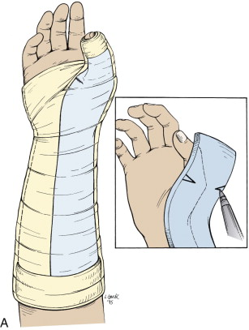
Thumb Spica Splint
Indications
Injuries to scaphoid, lunate, thumb and 1st metacarpal
Gamekeeper’s thumb
De Quervain tenosynovitis
Construction
From just distal to the interphalangeal joint of thumb to mid-forearm
Application/Positioning
Cut hole in stockinette for thumb
Forearm in neutral position with thumb in wineglass position

Slide 14
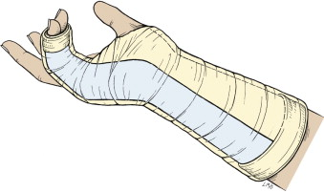
Ulnar Gutter Splint
Indications
Fractures and soft tissue injuries of 5th digit
Fractures of the neck, shaft, and base of 4th and 5th metacarpals.
Construction
Starts at mid-forearm, runs along ulnar aspect of forearm to just beyond the DIP joint
Include the 4th and 5th digits
Application/Positioning
Forearm in neutral
Slight wrist extension (10-20 degrees)
PIP and DIP joints 10-15 degrees of flexion
50 degrees of flexion of MCP joints
If Boxer’s fracture -> MCP joint flexed to 90 degrees

Slide 15
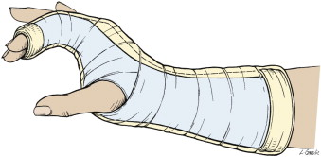
Radial Gutter Splint
Indications
Fractures and soft tissue injuries of index and 3rd digits
Fractures of the neck, shaft and base of the 2nd and 3rd metacarpals
Construction
Starts at mid-forearm, down the radial aspect of forearm to just distal to the DIP joint of 2nd and 3rd digits
Application/Positioning
Cut hole in stockinette and plaster for the thumb
Hand in position of function
Forearm in neutral position
Wrist slightly extended
MCP 50 degrees of flexion
PIP and DIP joints 5 to 10 degrees of flexion

Slide 16
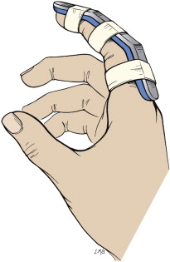
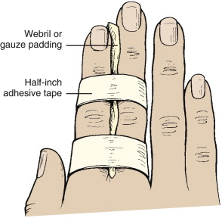
Finger Splints
Buddy tape
Indications: minor finger sprains
Aluminum finger splints
Phalanx fractures
After tendon repairs

Slide 17
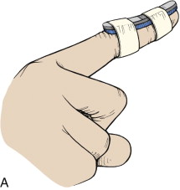
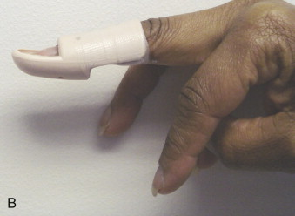
Finger Splints for Mallet Finger
Indication
Mallet Finger
Construction
Splint only the DIP joint
Application/Positioning
Splint DIP joint in hyperextension
Cannot be removed for 6-8 weeks

Slide 18
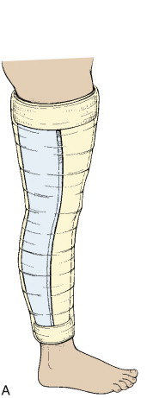
Posterior Knee Splint
Indications
Patients with legs too large for knee immobilizer
Angulated fractures
Injuries that require urgent operative fixation
Construction
Starts just below buttocks crease on dorsal aspect of leg to 5 to 8 cm above the malleoli
Application/Positioning
Slightly flexed knee (especially in kids so they don’t bear weight)

Slide 19
Jones Compression Dressing
Indications
Short-term immobilization of soft tissue injuries of knee
Not for injuries that require strict immobilization
Construction
Webril and Ace wrap from the groin to a few inches above the malleoli
2 to 3 layers of webril
Application
Slight flexion of the knee

Slide 20
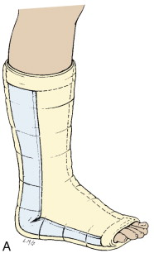
Posterior Ankle Splint (Post Mold)
Indications
Severe ankle sprains
Fractures of distal fibula and tibia
Reduced ankle dislocations
Can add stirrup splint for unstable ankle fractures
Construction
From plantar surface of the metatarsal heads to the level of the fibular head posteriorly
Application/Positioning
Most easily applied in the prone position
Ankle to 90 degrees

Slide 21
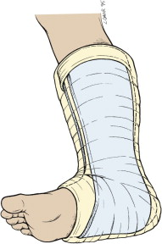
U-Splint/Stirrup Splint
Indications
Severe ankle sprains
Fractures of distal fibula and tibia
Reduced ankle dislocations
Can be added to post mold for unstable ankle fracture
Construction
Passes under the plantar surface of foot and extends up medial and lateral sides of leg to just below level of fibular head
Application/Positioning
Most easily applied in the prone position
Ankle to 90 degrees
If placed with post mold, place post mold first

